Slide 1
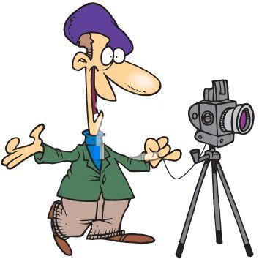
Basics of Image Processing
Mingkui Tan
mingkuitan@scut.edu.cn
Slides are mainly adapted from Prof. Yacov Hel-Or and Prof. Derek Hoiem.
Thank Yacov Hel-Or and Derek Hoiem!

Slide 2

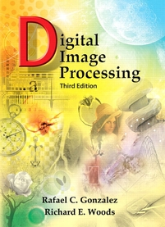


Textbooks
Digital Image Processing
Kenneth R. Castelman
Prentice Hall
--------------------------------------
Digital Image Processing
Rafael C. Gonzalez and Richards E. Woods,
Addison Wesley
--------------------------------------
Digital Image Processing
Rafael Gonzalez and Paul Wintz
Addison Wesley
--------------------------------------
Fundamentals of Digital Image Processing
Anil K. Jain
Prentice Hall, 1989.
--------------------------------------

Slide 3
About the course
Goals of this course:
Introductory course: Getting acquainted with basic properties of images
Basic concepts, classical methods, Getting acquainted with various representations of image data
Acquire fundamental knowledge in processing and analysis digital images
Pre-requisites:
Probability and Statistics
Matrix Computations

Slide 4
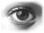
Basics on Images
Introduction to Image Processing
Image Processing Applications
Examples
Course Plan

Slide 5
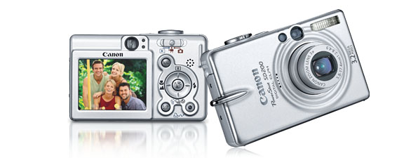
Digital camera
A digital camera replaces film with a sensor array
Each cell in the array is light-sensitive diode that converts photons to electrons
Two common types: Charge Coupled Device (CCD) and CMOS
http://electronics.howstuffworks.com/digital-camera.htm
Slide by Steve Seitz

Slide 6

How light is recorded

Slide 7
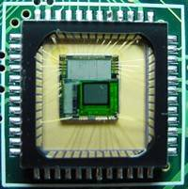

Sensor Array
CMOS sensor
Each sensor cell records amount of light coming in at a small range of orientations

Slide 8
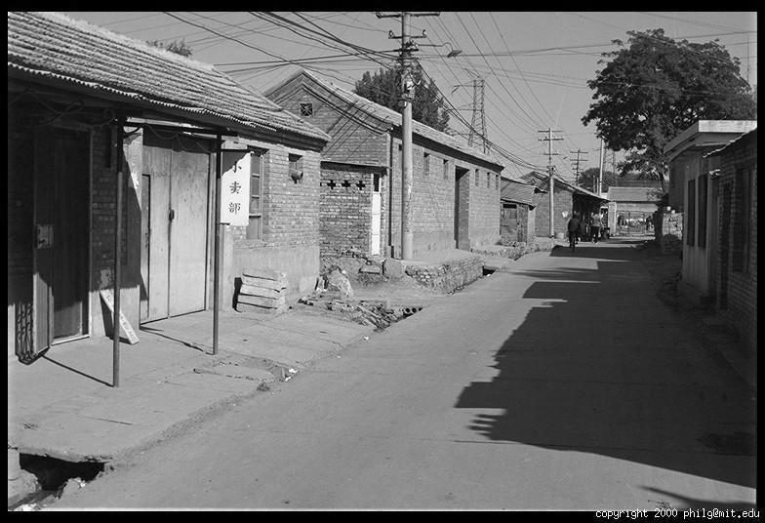
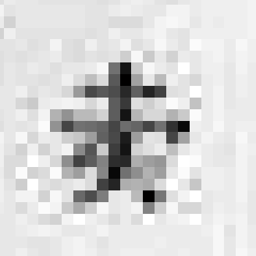
The raster image (pixel matrix)

Slide 9
The raster image (pixel matrix)
0.92 | 0.93 | 0.94 | 0.97 | 0.62 | 0.37 | 0.85 | 0.97 | 0.93 | 0.92 | 0.99
0.95 | 0.89 | 0.82 | 0.89 | 0.56 | 0.31 | 0.75 | 0.92 | 0.81 | 0.95 | 0.91
0.89 | 0.72 | 0.51 | 0.55 | 0.51 | 0.42 | 0.57 | 0.41 | 0.49 | 0.91 | 0.92
0.96 | 0.95 | 0.88 | 0.94 | 0.56 | 0.46 | 0.91 | 0.87 | 0.90 | 0.97 | 0.95
0.71 | 0.81 | 0.81 | 0.87 | 0.57 | 0.37 | 0.80 | 0.88 | 0.89 | 0.79 | 0.85
0.49 | 0.62 | 0.60 | 0.58 | 0.50 | 0.60 | 0.58 | 0.50 | 0.61 | 0.45 | 0.33
0.86 | 0.84 | 0.74 | 0.58 | 0.51 | 0.39 | 0.73 | 0.92 | 0.91 | 0.49 | 0.74
0.96 | 0.67 | 0.54 | 0.85 | 0.48 | 0.37 | 0.88 | 0.90 | 0.94 | 0.82 | 0.93
0.69 | 0.49 | 0.56 | 0.66 | 0.43 | 0.42 | 0.77 | 0.73 | 0.71 | 0.90 | 0.99
0.79 | 0.73 | 0.90 | 0.67 | 0.33 | 0.61 | 0.69 | 0.79 | 0.73 | 0.93 | 0.97
0.91 | 0.94 | 0.89 | 0.49 | 0.41 | 0.78 | 0.78 | 0.77 | 0.89 | 0.99 | 0.93

Slide 10
Today’s class: Light and Shading
What determines a pixel’s intensity?
What can we infer about the scene from pixel intensities?

Slide 11
How does a pixel get its value?
Light emitted
Fraction of light reflects into camera
Lens
Sensor

Slide 12
How does a pixel get its value?
Major factors
Illumination strength and direction
Surface geometry
Surface material
Nearby surfaces
Camera gain/exposure
Light emitted
Light reflected to camera
Sensor

Slide 13
Gray Image (One Single Matrix)
0.92 | 0.93 | 0.94 | 0.97 | 0.62 | 0.37 | 0.85 | 0.97 | 0.93 | 0.92 | 0.99
0.95 | 0.89 | 0.82 | 0.89 | 0.56 | 0.31 | 0.75 | 0.92 | 0.81 | 0.95 | 0.91
0.89 | 0.72 | 0.51 | 0.55 | 0.51 | 0.42 | 0.57 | 0.41 | 0.49 | 0.91 | 0.92
0.96 | 0.95 | 0.88 | 0.94 | 0.56 | 0.46 | 0.91 | 0.87 | 0.90 | 0.97 | 0.95
0.71 | 0.81 | 0.81 | 0.87 | 0.57 | 0.37 | 0.80 | 0.88 | 0.89 | 0.79 | 0.85
0.49 | 0.62 | 0.60 | 0.58 | 0.50 | 0.60 | 0.58 | 0.50 | 0.61 | 0.45 | 0.33
0.86 | 0.84 | 0.74 | 0.58 | 0.51 | 0.39 | 0.73 | 0.92 | 0.91 | 0.49 | 0.74
0.96 | 0.67 | 0.54 | 0.85 | 0.48 | 0.37 | 0.88 | 0.90 | 0.94 | 0.82 | 0.93
0.69 | 0.49 | 0.56 | 0.66 | 0.43 | 0.42 | 0.77 | 0.73 | 0.71 | 0.90 | 0.99
0.79 | 0.73 | 0.90 | 0.67 | 0.33 | 0.61 | 0.69 | 0.79 | 0.73 | 0.93 | 0.97
0.91 | 0.94 | 0.89 | 0.49 | 0.41 | 0.78 | 0.78 | 0.77 | 0.89 | 0.99 | 0.93

Slide 14
Image summary
F(x_{i},y_{j})
i = 0 --> N-1
j = 0 --> M-1
N*M = spatial resolution, size of image
L = intensity levels, grey levels
B = no. of bits (1, 2, 4, 8, 16, 32)

Slide 15
Digital Image Storage
Stored in two parts
header
width, height … cookie.
Cookie is an indicator of what type of image file
data
uncompressed, compressed, ascii, binary.
File types
JPEG, BMP, PPM.

Slide 16
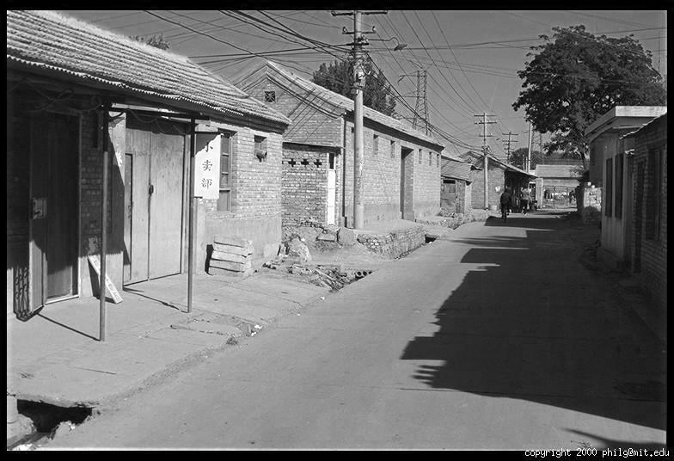
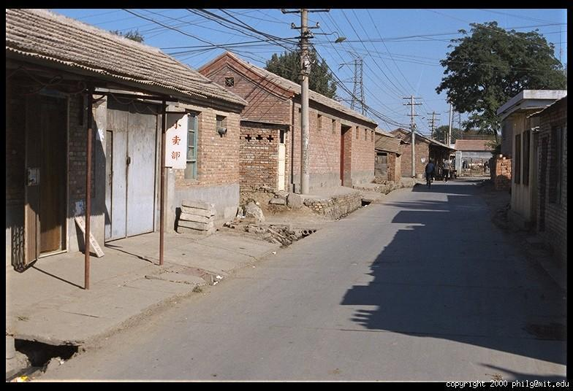
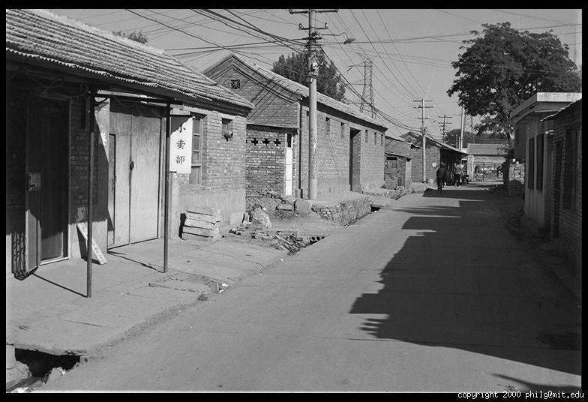
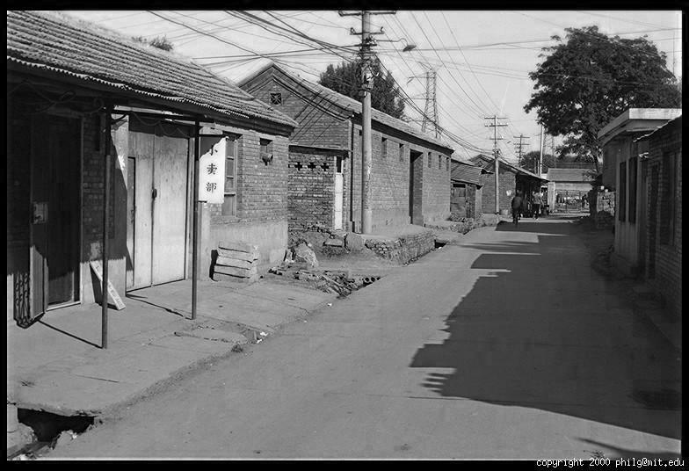
Color Image
R
G
B

Slide 17
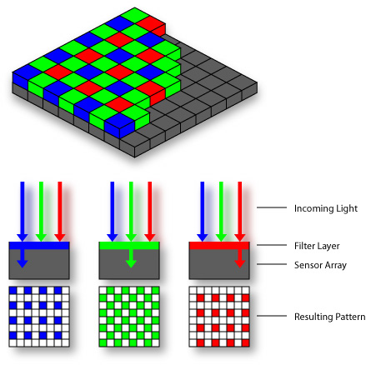
Digital Color Images
Bayer Filter
CMOS sensor

Slide 18
Images in Matlab
Images represented as a matrix
Suppose we have a NxM RGB image called “im”
im(1,1,1) = top-left pixel value in R-channel
im(y, x, b) = y pixels down, x pixels to right in the b^{th} channel
im(N, M, 3) = bottom-right pixel in B-channel
imread(filename) returns a uint8 image (values 0 to 255)
Convert to double format (values 0 to 1) with im2double
column
row
R
0.92 | 0.93 | 0.94 | 0.97 | 0.62 | 0.37 | 0.85 | 0.97 | 0.93 | 0.92 | 0.99
0.95 | 0.89 | 0.82 | 0.89 | 0.56 | 0.31 | 0.75 | 0.92 | 0.81 | 0.95 | 0.91
0.89 | 0.72 | 0.51 | 0.55 | 0.51 | 0.42 | 0.57 | 0.41 | 0.49 | 0.91 | 0.92
0.96 | 0.95 | 0.88 | 0.94 | 0.56 | 0.46 | 0.91 | 0.87 | 0.90 | 0.97 | 0.95
0.71 | 0.81 | 0.81 | 0.87 | 0.57 | 0.37 | 0.80 | 0.88 | 0.89 | 0.79 | 0.85
0.49 | 0.62 | 0.60 | 0.58 | 0.50 | 0.60 | 0.58 | 0.50 | 0.61 | 0.45 | 0.33
0.86 | 0.84 | 0.74 | 0.58 | 0.51 | 0.39 | 0.73 | 0.92 | 0.91 | 0.49 | 0.74
0.96 | 0.67 | 0.54 | 0.85 | 0.48 | 0.37 | 0.88 | 0.90 | 0.94 | 0.82 | 0.93
0.69 | 0.49 | 0.56 | 0.66 | 0.43 | 0.42 | 0.77 | 0.73 | 0.71 | 0.90 | 0.99
0.79 | 0.73 | 0.90 | 0.67 | 0.33 | 0.61 | 0.69 | 0.79 | 0.73 | 0.93 | 0.97
0.91 | 0.94 | 0.89 | 0.49 | 0.41 | 0.78 | 0.78 | 0.77 | 0.89 | 0.99 | 0.93
G
0.92 | 0.93 | 0.94 | 0.97 | 0.62 | 0.37 | 0.85 | 0.97 | 0.93 | 0.92 | 0.99
0.95 | 0.89 | 0.82 | 0.89 | 0.56 | 0.31 | 0.75 | 0.92 | 0.81 | 0.95 | 0.91
0.89 | 0.72 | 0.51 | 0.55 | 0.51 | 0.42 | 0.57 | 0.41 | 0.49 | 0.91 | 0.92
0.96 | 0.95 | 0.88 | 0.94 | 0.56 | 0.46 | 0.91 | 0.87 | 0.90 | 0.97 | 0.95
0.71 | 0.81 | 0.81 | 0.87 | 0.57 | 0.37 | 0.80 | 0.88 | 0.89 | 0.79 | 0.85
0.49 | 0.62 | 0.60 | 0.58 | 0.50 | 0.60 | 0.58 | 0.50 | 0.61 | 0.45 | 0.33
0.86 | 0.84 | 0.74 | 0.58 | 0.51 | 0.39 | 0.73 | 0.92 | 0.91 | 0.49 | 0.74
0.96 | 0.67 | 0.54 | 0.85 | 0.48 | 0.37 | 0.88 | 0.90 | 0.94 | 0.82 | 0.93
0.69 | 0.49 | 0.56 | 0.66 | 0.43 | 0.42 | 0.77 | 0.73 | 0.71 | 0.90 | 0.99
0.79 | 0.73 | 0.90 | 0.67 | 0.33 | 0.61 | 0.69 | 0.79 | 0.73 | 0.93 | 0.97
0.91 | 0.94 | 0.89 | 0.49 | 0.41 | 0.78 | 0.78 | 0.77 | 0.89 | 0.99 | 0.93
B
0.92 | 0.93 | 0.94 | 0.97 | 0.62 | 0.37 | 0.85 | 0.97 | 0.93 | 0.92 | 0.99
0.95 | 0.89 | 0.82 | 0.89 | 0.56 | 0.31 | 0.75 | 0.92 | 0.81 | 0.95 | 0.91
0.89 | 0.72 | 0.51 | 0.55 | 0.51 | 0.42 | 0.57 | 0.41 | 0.49 | 0.91 | 0.92
0.96 | 0.95 | 0.88 | 0.94 | 0.56 | 0.46 | 0.91 | 0.87 | 0.90 | 0.97 | 0.95
0.71 | 0.81 | 0.81 | 0.87 | 0.57 | 0.37 | 0.80 | 0.88 | 0.89 | 0.79 | 0.85
0.49 | 0.62 | 0.60 | 0.58 | 0.50 | 0.60 | 0.58 | 0.50 | 0.61 | 0.45 | 0.33
0.86 | 0.84 | 0.74 | 0.58 | 0.51 | 0.39 | 0.73 | 0.92 | 0.91 | 0.49 | 0.74
0.96 | 0.67 | 0.54 | 0.85 | 0.48 | 0.37 | 0.88 | 0.90 | 0.94 | 0.82 | 0.93
0.69 | 0.49 | 0.56 | 0.66 | 0.43 | 0.42 | 0.77 | 0.73 | 0.71 | 0.90 | 0.99
0.79 | 0.73 | 0.90 | 0.67 | 0.33 | 0.61 | 0.69 | 0.79 | 0.73 | 0.93 | 0.97
0.91 | 0.94 | 0.89 | 0.49 | 0.41 | 0.78 | 0.78 | 0.77 | 0.89 | 0.99 | 0.93

Slide 19
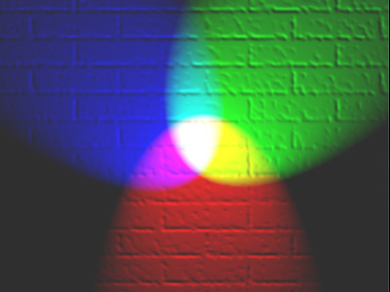
Color spaces
How can we represent color?
http://en.wikipedia.org/wiki/File:RGB_illumination.jpg

Slide 20

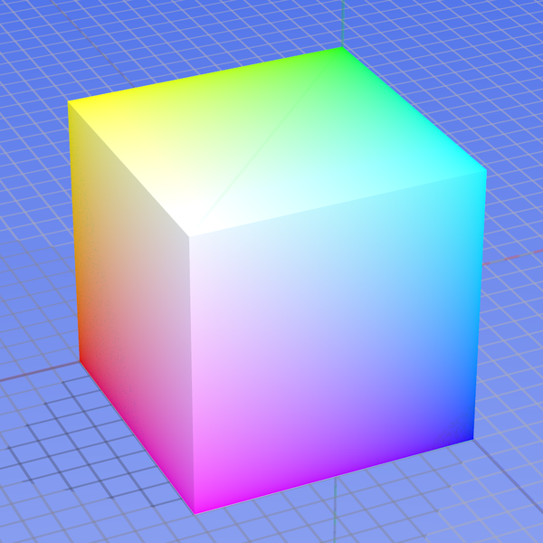
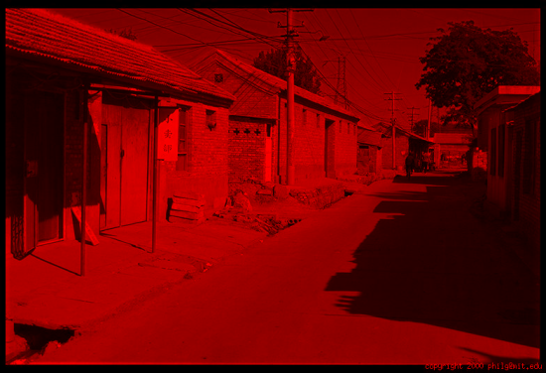
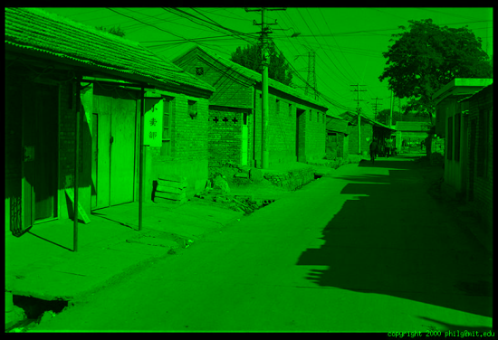
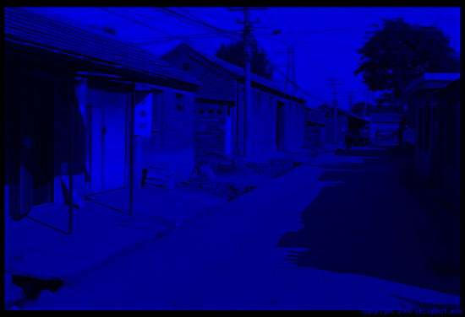
Color spaces: RGB
Default color space
0,1,0
R
(G=0,B=0)
1,0,0
G
(R=0,B=0)
0,0,1
B
(R=0,G=0)
Some drawbacks
Strongly correlated channels
Non-perceptual
Image from: http://en.wikipedia.org/wiki/File:RGB_color_solid_cube.png

Slide 21
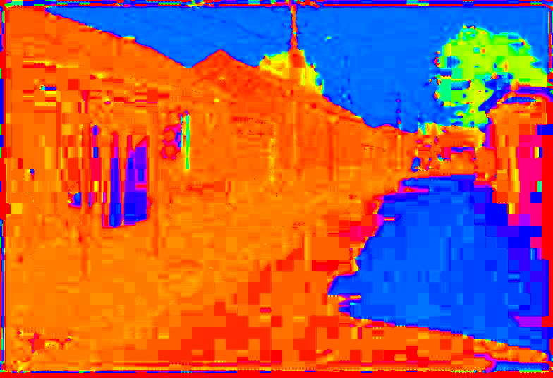
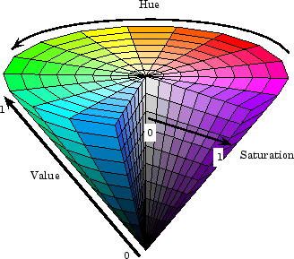
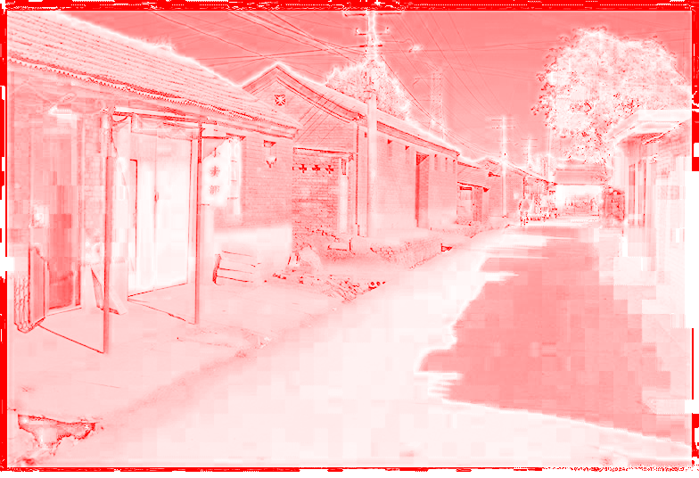
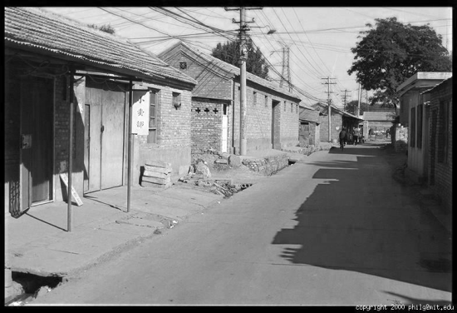
Color spaces: HSV
Intuitive color space
H
(S=1,V=1)
S
(H=1,V=1)
V
(H=1,S=0)

Slide 22
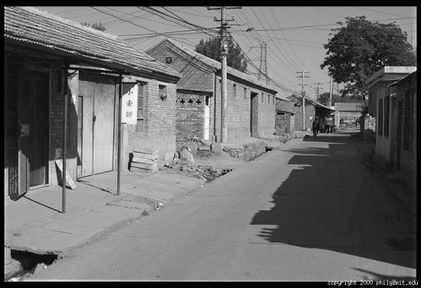





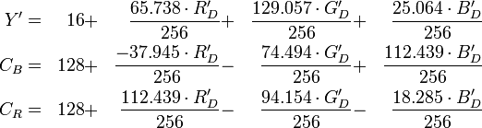
Color spaces: YCbCr
Fast to compute, good for compression, used by TV
Y=0
Y=0.5
Y
(Cb=0.5,Cr=0.5)
Cr
Cb
(Y=0.5,Cr=0.5)
Cb
Y=1
Cr
(Y=0.5,Cb=05)

Slide 23
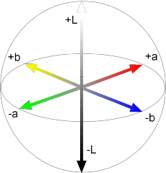

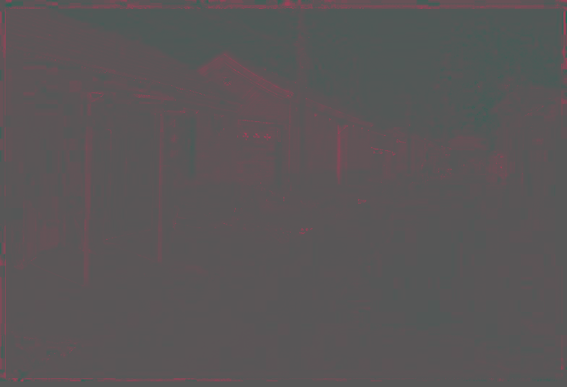

Color spaces: CIE L*a*b*
“Perceptually uniform” color space
L
(a=0,b=0)
a
(L=65,b=0)
b
(L=65,a=0)
Luminance = brightness
Chrominance = color

Slide 24
Which contains more information? (a) intensity (1 channel) (b) chrominance (色度 2 channels)

Slide 25
If you had to choose, would you rather go without luminance or chrominance?

Slide 26
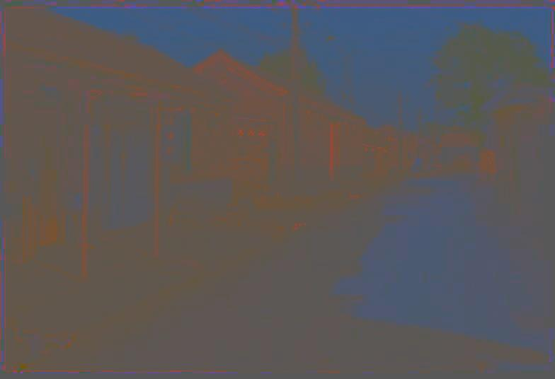
Only color shown – constant intensity
Only color shown – constant intensity

Slide 27
Only intensity shown – constant color
Only intensity shown – constant color

Slide 28
Most information in intensity
Original image

Slide 29
Basics of Image Processing
Mingkui Tan
mingkuitan@scut.edu.cn
Slides are mainly adapted from Prof. Yacov Hel-Or and Prof. Derek Hoiem.
Thank Yacov Hel-Or and Derek Hoiem!

Slide 30
Image Processing v.s. Computer Vision
Low Level
Image Processing
Acquisition, representation,
compression, transmission
image enhancement
edge/feature extraction
Pattern matching
image "understanding“
(Recognition, 3D)
Computer Vision
High Level

Slide 31
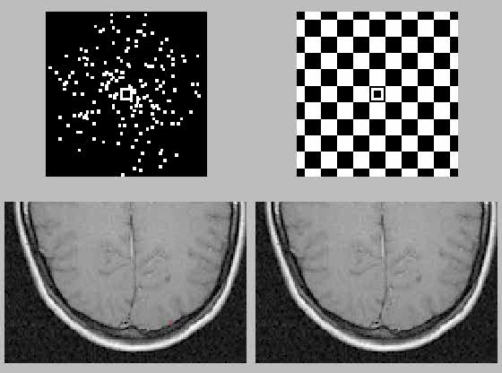
Image Processing and Computer Vision are Interdisciplinary Fields
Mathematical Models (CS, EE, Math)
Eye Research (Biology)
Brain Research:
Psychophysics (Psychologists)
Electro-physiology (Biologists)
Functional MRI (Biologists)

Slide 32
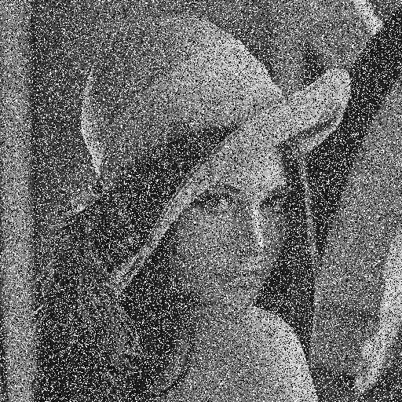
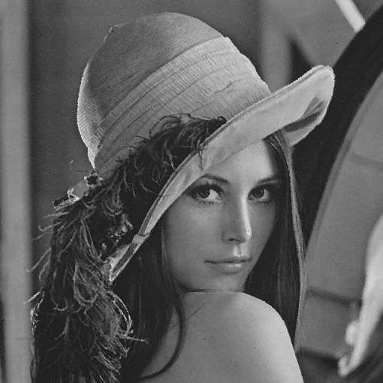
Image Denoising

Slide 33
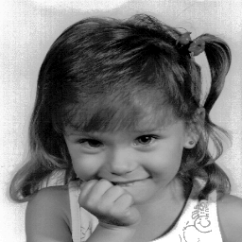
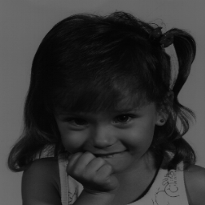
Image Enhancement

Slide 34
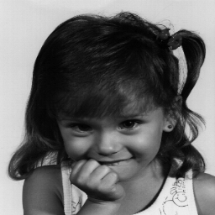

Image Deblurring

Slide 35
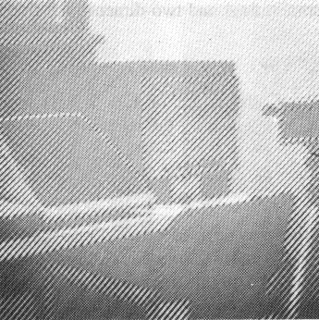
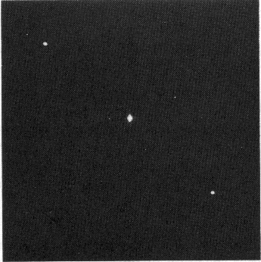
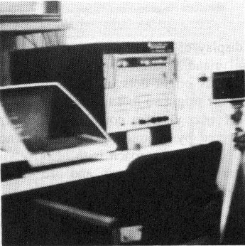
Operations in Frequency Domain
Original Noisy image
Fourier Spectrum
Filtered image

Slide 36
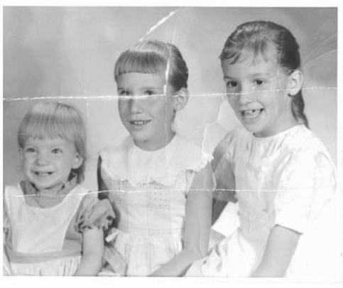

Image Inpainting 1

Slide 37
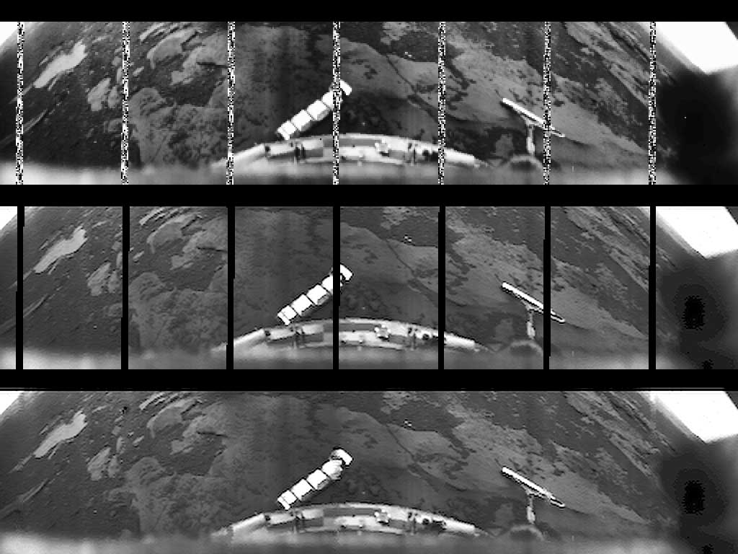
Image Inpainting 2
Images of Venus taken by the Russian lander Ventra-10 in 1975

Slide 38
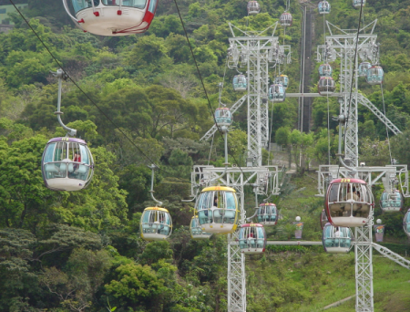
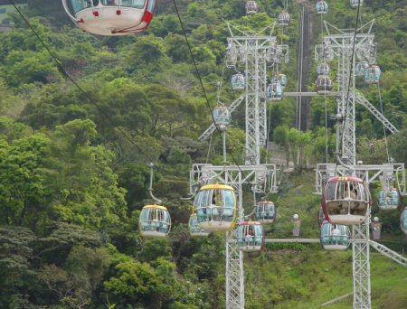
Image Inpainting 3

Slide 39
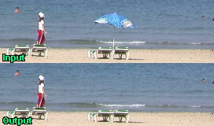
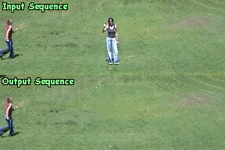
Video Inpainting
Y. Wexler, E. Shechtman and M. Irani 2004

Slide 40
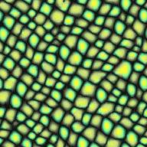

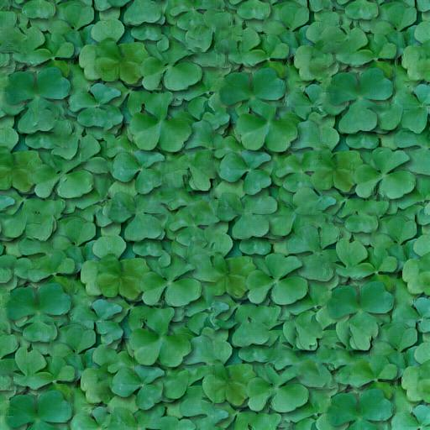
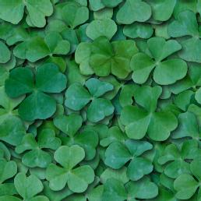
Texture Synthesis

Slide 41
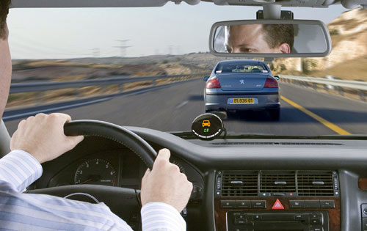
Industry and Applications
Automobile driver assistance
Lane departure warning
Adaptive cruise control
Obstacle warning
Digital Photography
Image Enhancement
Compression
Color manipulation
Image editing
Digital cameras
Sports analysis
sports refereeing and commentary
3D visualization and tracking sports actions
MobilEye system

Slide 42
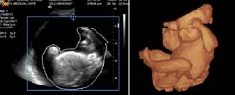
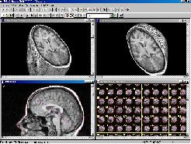
Film and Video
Editing
Special effects
Image Database
Content based image retrieval
visual search of products
Face recognition
Industrial Automation and Inspection
vision-guided robotics
Inspection systems
Medical and Biomedical
Surgical assistance
Sensor fusion
Vision based diagnosis
Astronomy
Astronomical Image Enhancement
Chemical/Spectral Analysis

Slide 43
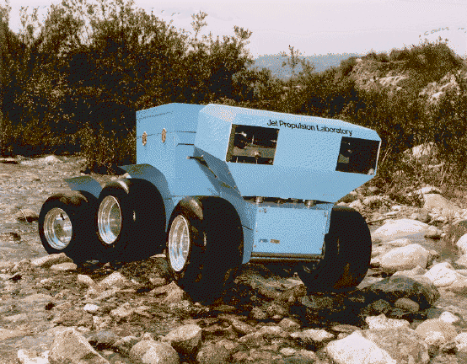
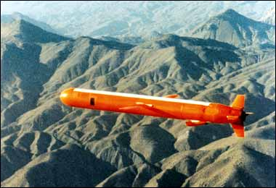
Arial Photography
Image Enhancement
Missile Guidance
Geological Mapping
Robotics
Autonomous Vehicles
Security and Safety
Biometry verification (face, iris)
Surveillance (fences, swimming pools)
Military
Tracking and localizing
Detection
Missile guidance
Traffic and Road Monitoring
Traffic monitoring
Adaptive traffic lights
Cruise Missiles

Slide 44
Why Computer Vision is Hard?

Slide 45
Gray Image (One Single Matrix)
0.92 | 0.93 | 0.94 | 0.97 | 0.62 | 0.37 | 0.85 | 0.97 | 0.93 | 0.92 | 0.99
0.95 | 0.89 | 0.82 | 0.89 | 0.56 | 0.31 | 0.75 | 0.92 | 0.81 | 0.95 | 0.91
0.89 | 0.72 | 0.51 | 0.55 | 0.51 | 0.42 | 0.57 | 0.41 | 0.49 | 0.91 | 0.92
0.96 | 0.95 | 0.88 | 0.94 | 0.56 | 0.46 | 0.91 | 0.87 | 0.90 | 0.97 | 0.95
0.71 | 0.81 | 0.81 | 0.87 | 0.57 | 0.37 | 0.80 | 0.88 | 0.89 | 0.79 | 0.85
0.49 | 0.62 | 0.60 | 0.58 | 0.50 | 0.60 | 0.58 | 0.50 | 0.61 | 0.45 | 0.33
0.86 | 0.84 | 0.74 | 0.58 | 0.51 | 0.39 | 0.73 | 0.92 | 0.91 | 0.49 | 0.74
0.96 | 0.67 | 0.54 | 0.85 | 0.48 | 0.37 | 0.88 | 0.90 | 0.94 | 0.82 | 0.93
0.69 | 0.49 | 0.56 | 0.66 | 0.43 | 0.42 | 0.77 | 0.73 | 0.71 | 0.90 | 0.99
0.79 | 0.73 | 0.90 | 0.67 | 0.33 | 0.61 | 0.69 | 0.79 | 0.73 | 0.93 | 0.97
0.91 | 0.94 | 0.89 | 0.49 | 0.41 | 0.78 | 0.78 | 0.77 | 0.89 | 0.99 | 0.93

Slide 46
Why Computer Vision is Hard?
Inverse problems
Priori-knowledge is required
Complexity extensive
Top-Down v.s. Bottom-Up paradigm
Parallelism
Non-local operations
Propagation of Information

Slide 47
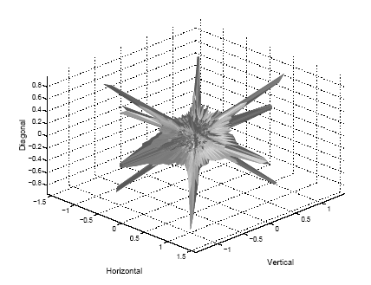
Prior Models of Images
3D prior of 2x2 image neighborhoods, From Mumford & Huang, 2000

Slide 48
Syllabus
Point Operations
Geometric Operations
Spatial Operation
Frequency Domain and the FFT
Image Operations in Freq. Domain
Multi-Resolution
Restoration
Feature Extraction

Slide 49
Image Operations
Point Operations
Geometric Operations
Spatial Operations
Global Operations (Freq. domain)
Multi-Resolution Operations

Slide 50
Point Operations

Slide 51


Geometric Operations

Slide 52


Geometric and Point Operations

Slide 53
Spatial Operations

Slide 54

Global Operations

Slide 55
Global Operations
Image domain
Freq. domain

Slide 56


The Fourier Transform
Jean Baptiste Joseph Fourier 1768-1830

Slide 57
Multi-Resolution
Low resolution
High resolution

Slide 58

Multi-Resolution Operations

Slide 59
Image Filtering
Mingkui Tan
mingkuitan@scut.edu.cn
Slides are mainly adapted from Prof. Yacov Hel-Or and Prof. Derek Hoiem.
Thank Yacov Hel-Or and Derek Hoiem!

Slide 60
Basis for interpreting intensity images
Key idea: for nearby scene points, most factors do not change much
The information is mainly contained in local differences of brightness

Slide 61

Darkness = Large Difference in Neighboring Pixels

Slide 62
Three views of filtering
Image filters in spatial domain
Filter is a mathematical operation on values of each patch
Smoothing, sharpening, measuring texture
Image filters in the frequency domain
Filtering is a way to modify the frequencies of images
Denoising, sampling, image compression
Templates and Image Pyramids
Filtering is a way to match a template to the image
Detection, coarse-to-fine registration

Slide 63
The gray image (pixel matrix)
0.92 | 0.93 | 0.94 | 0.97 | 0.62 | 0.37 | 0.85 | 0.97 | 0.93 | 0.92 | 0.99
0.95 | 0.89 | 0.82 | 0.89 | 0.56 | 0.31 | 0.75 | 0.92 | 0.81 | 0.95 | 0.91
0.89 | 0.72 | 0.51 | 0.55 | 0.51 | 0.42 | 0.57 | 0.41 | 0.49 | 0.91 | 0.92
0.96 | 0.95 | 0.88 | 0.94 | 0.56 | 0.46 | 0.91 | 0.87 | 0.90 | 0.97 | 0.95
0.71 | 0.81 | 0.81 | 0.87 | 0.57 | 0.37 | 0.80 | 0.88 | 0.89 | 0.79 | 0.85
0.49 | 0.62 | 0.60 | 0.58 | 0.50 | 0.60 | 0.58 | 0.50 | 0.61 | 0.45 | 0.33
0.86 | 0.84 | 0.74 | 0.58 | 0.51 | 0.39 | 0.73 | 0.92 | 0.91 | 0.49 | 0.74
0.96 | 0.67 | 0.54 | 0.85 | 0.48 | 0.37 | 0.88 | 0.90 | 0.94 | 0.82 | 0.93
0.69 | 0.49 | 0.56 | 0.66 | 0.43 | 0.42 | 0.77 | 0.73 | 0.71 | 0.90 | 0.99
0.79 | 0.73 | 0.90 | 0.67 | 0.33 | 0.61 | 0.69 | 0.79 | 0.73 | 0.93 | 0.97
0.91 | 0.94 | 0.89 | 0.49 | 0.41 | 0.78 | 0.78 | 0.77 | 0.89 | 0.99 | 0.93

Slide 64
Image filtering
Image filtering: for each pixel, compute function of local neighborhood and output a new value
Same function applied at each position
Output and input image are typically the same size

Slide 65
Image filtering or Convolution
Linear filtering: a weighted sum/difference of pixel values
Really important!
Enhance images
Denoising, smooth, increase contrast, blurring, noise reduction, image sharpening etc.
Extract information from images
Texture, edges, distinctive points, etc.
Detect patterns
Template matching
Detect patterns
Deep Learning
Convolutional Neural Networks

Slide 66


Concept of convolution
Black box

Slide 67

Concept of convolution
g(x,y) = h(x,y) * f(x,y) mask convolved with an image
g(x,y) = f(x,y) * h(x,y) image convolved with mask
The convolution operator (*) is commutative, h(x,y) is the mask or filter.

Slide 68
Convolution mask
Mask is a matrix, usually of size 1x1, 3x3, 5x5 or 7x7 (odd number).
Convolution steps:
Flip the mask horizontally and vertically
Slide the mask onto the image
Multiply the corresponding elements and add them
Repeat this until all image values are calculated

Slide 69


Convolution example
Image matrix
Place the mask over each image element. Multiply the corresponding elements and add them

Slide 70

Concept of mask
A mask is a filter.
Concept of masking is a concept of spatial filtering.
Sample mask
Filtering is convolving a mask with an image by moving the center of the mask over each image pixel.

Slide 71
Convolution example
Red – mask, black – image
First pixel: = (5*2) + (4*4) + (2*8) + (1*10)
= 10 + 16 + 16 + 10
= 52
Convolution can achieve blurring, edge detection, sharpening, noise reduction, etc

Slide 72

Example: box filter
1
1
1
1
1
1
1
1
1
Slide credit: David Lowe (UBC)

Slide 73
Image filtering
1
1
1
1
1
1
1
1
1
0 | 0 | 0 | 0 | 0 | 0 | 0 | 0 | 0 | 0
0 | 0 | 0 | 0 | 0 | 0 | 0 | 0 | 0 | 0
0 | 0 | 0 | 90 | 90 | 90 | 90 | 90 | 0 | 0
0 | 0 | 0 | 90 | 90 | 90 | 90 | 90 | 0 | 0
0 | 0 | 0 | 90 | 90 | 90 | 90 | 90 | 0 | 0
0 | 0 | 0 | 90 | 0 | 90 | 90 | 90 | 0 | 0
0 | 0 | 0 | 90 | 90 | 90 | 90 | 90 | 0 | 0
0 | 0 | 0 | 0 | 0 | 0 | 0 | 0 | 0 | 0
0 | 0 | 90 | 0 | 0 | 0 | 0 | 0 | 0 | 0
0 | 0 | 0 | 0 | 0 | 0 | 0 | 0 | 0 | 0
 | 0
Credit: S. Seitz
Notes:
ones, divide by 9

Slide 74
Image filtering
1
1
1
1
1
1
1
1
1
0 | 0 | 0 | 0 | 0 | 0 | 0 | 0 | 0 | 0
0 | 0 | 0 | 0 | 0 | 0 | 0 | 0 | 0 | 0
0 | 0 | 0 | 90 | 90 | 90 | 90 | 90 | 0 | 0
0 | 0 | 0 | 90 | 90 | 90 | 90 | 90 | 0 | 0
0 | 0 | 0 | 90 | 90 | 90 | 90 | 90 | 0 | 0
0 | 0 | 0 | 90 | 0 | 90 | 90 | 90 | 0 | 0
0 | 0 | 0 | 90 | 90 | 90 | 90 | 90 | 0 | 0
0 | 0 | 0 | 0 | 0 | 0 | 0 | 0 | 0 | 0
0 | 0 | 90 | 0 | 0 | 0 | 0 | 0 | 0 | 0
0 | 0 | 0 | 0 | 0 | 0 | 0 | 0 | 0 | 0
 | 0 | 10
0 | 0 | 0 | 0 | 0 | 0 | 0 | 0 | 0 | 0
0 | 0 | 0 | 0 | 0 | 0 | 0 | 0 | 0 | 0
0 | 0 | 0 | 90 | 90 | 90 | 90 | 90 | 0 | 0
0 | 0 | 0 | 90 | 90 | 90 | 90 | 90 | 0 | 0
0 | 0 | 0 | 90 | 90 | 90 | 90 | 90 | 0 | 0
0 | 0 | 0 | 90 | 0 | 90 | 90 | 90 | 0 | 0
0 | 0 | 0 | 90 | 90 | 90 | 90 | 90 | 0 | 0
0 | 0 | 0 | 0 | 0 | 0 | 0 | 0 | 0 | 0
0 | 0 | 90 | 0 | 0 | 0 | 0 | 0 | 0 | 0
0 | 0 | 0 | 0 | 0 | 0 | 0 | 0 | 0 | 0
Credit: S. Seitz
Notes:
ones, divide by 9

Slide 75
Image filtering
1
1
1
1
1
1
1
1
1
0 | 0 | 0 | 0 | 0 | 0 | 0 | 0 | 0 | 0
0 | 0 | 0 | 0 | 0 | 0 | 0 | 0 | 0 | 0
0 | 0 | 0 | 90 | 90 | 90 | 90 | 90 | 0 | 0
0 | 0 | 0 | 90 | 90 | 90 | 90 | 90 | 0 | 0
0 | 0 | 0 | 90 | 90 | 90 | 90 | 90 | 0 | 0
0 | 0 | 0 | 90 | 0 | 90 | 90 | 90 | 0 | 0
0 | 0 | 0 | 90 | 90 | 90 | 90 | 90 | 0 | 0
0 | 0 | 0 | 0 | 0 | 0 | 0 | 0 | 0 | 0
0 | 0 | 90 | 0 | 0 | 0 | 0 | 0 | 0 | 0
0 | 0 | 0 | 0 | 0 | 0 | 0 | 0 | 0 | 0
 | 0 | 10 | 20
0 | 0 | 0 | 0 | 0 | 0 | 0 | 0 | 0 | 0
0 | 0 | 0 | 0 | 0 | 0 | 0 | 0 | 0 | 0
0 | 0 | 0 | 90 | 90 | 90 | 90 | 90 | 0 | 0
0 | 0 | 0 | 90 | 90 | 90 | 90 | 90 | 0 | 0
0 | 0 | 0 | 90 | 90 | 90 | 90 | 90 | 0 | 0
0 | 0 | 0 | 90 | 0 | 90 | 90 | 90 | 0 | 0
0 | 0 | 0 | 90 | 90 | 90 | 90 | 90 | 0 | 0
0 | 0 | 0 | 0 | 0 | 0 | 0 | 0 | 0 | 0
0 | 0 | 90 | 0 | 0 | 0 | 0 | 0 | 0 | 0
0 | 0 | 0 | 0 | 0 | 0 | 0 | 0 | 0 | 0
Credit: S. Seitz
Notes:
ones, divide by 9

Slide 76
Image filtering
1
1
1
1
1
1
1
1
1
0 | 0 | 0 | 0 | 0 | 0 | 0 | 0 | 0 | 0
0 | 0 | 0 | 0 | 0 | 0 | 0 | 0 | 0 | 0
0 | 0 | 0 | 90 | 90 | 90 | 90 | 90 | 0 | 0
0 | 0 | 0 | 90 | 90 | 90 | 90 | 90 | 0 | 0
0 | 0 | 0 | 90 | 90 | 90 | 90 | 90 | 0 | 0
0 | 0 | 0 | 90 | 0 | 90 | 90 | 90 | 0 | 0
0 | 0 | 0 | 90 | 90 | 90 | 90 | 90 | 0 | 0
0 | 0 | 0 | 0 | 0 | 0 | 0 | 0 | 0 | 0
0 | 0 | 90 | 0 | 0 | 0 | 0 | 0 | 0 | 0
0 | 0 | 0 | 0 | 0 | 0 | 0 | 0 | 0 | 0
 | 0 | 10 | 20 | 30
0 | 0 | 0 | 0 | 0 | 0 | 0 | 0 | 0 | 0
0 | 0 | 0 | 0 | 0 | 0 | 0 | 0 | 0 | 0
0 | 0 | 0 | 90 | 90 | 90 | 90 | 90 | 0 | 0
0 | 0 | 0 | 90 | 90 | 90 | 90 | 90 | 0 | 0
0 | 0 | 0 | 90 | 90 | 90 | 90 | 90 | 0 | 0
0 | 0 | 0 | 90 | 0 | 90 | 90 | 90 | 0 | 0
0 | 0 | 0 | 90 | 90 | 90 | 90 | 90 | 0 | 0
0 | 0 | 0 | 0 | 0 | 0 | 0 | 0 | 0 | 0
0 | 0 | 90 | 0 | 0 | 0 | 0 | 0 | 0 | 0
0 | 0 | 0 | 0 | 0 | 0 | 0 | 0 | 0 | 0
Credit: S. Seitz
Notes:
ones, divide by 9

Slide 77
Image filtering
1
1
1
1
1
1
1
1
1
0 | 0 | 0 | 0 | 0 | 0 | 0 | 0 | 0 | 0
0 | 0 | 0 | 0 | 0 | 0 | 0 | 0 | 0 | 0
0 | 0 | 0 | 90 | 90 | 90 | 90 | 90 | 0 | 0
0 | 0 | 0 | 90 | 90 | 90 | 90 | 90 | 0 | 0
0 | 0 | 0 | 90 | 90 | 90 | 90 | 90 | 0 | 0
0 | 0 | 0 | 90 | 0 | 90 | 90 | 90 | 0 | 0
0 | 0 | 0 | 90 | 90 | 90 | 90 | 90 | 0 | 0
0 | 0 | 0 | 0 | 0 | 0 | 0 | 0 | 0 | 0
0 | 0 | 90 | 0 | 0 | 0 | 0 | 0 | 0 | 0
0 | 0 | 0 | 0 | 0 | 0 | 0 | 0 | 0 | 0
 | 0 | 10 | 20 | 30 | 30
Credit: S. Seitz
Notes:
ones, divide by 9

Slide 78
Image filtering
1
1
1
1
1
1
1
1
1
0 | 0 | 0 | 0 | 0 | 0 | 0 | 0 | 0 | 0
0 | 0 | 0 | 0 | 0 | 0 | 0 | 0 | 0 | 0
0 | 0 | 0 | 90 | 90 | 90 | 90 | 90 | 0 | 0
0 | 0 | 0 | 90 | 90 | 90 | 90 | 90 | 0 | 0
0 | 0 | 0 | 90 | 90 | 90 | 90 | 90 | 0 | 0
0 | 0 | 0 | 90 | 0 | 90 | 90 | 90 | 0 | 0
0 | 0 | 0 | 90 | 90 | 90 | 90 | 90 | 0 | 0
0 | 0 | 0 | 0 | 0 | 0 | 0 | 0 | 0 | 0
0 | 0 | 90 | 0 | 0 | 0 | 0 | 0 | 0 | 0
0 | 0 | 0 | 0 | 0 | 0 | 0 | 0 | 0 | 0
 | 0 | 10 | 20 | 30 | 30
?
Credit: S. Seitz
Notes:
ones, divide by 9

Slide 79
Image filtering
1
1
1
1
1
1
1
1
1
0 | 0 | 0 | 0 | 0 | 0 | 0 | 0 | 0 | 0
0 | 0 | 0 | 0 | 0 | 0 | 0 | 0 | 0 | 0
0 | 0 | 0 | 90 | 90 | 90 | 90 | 90 | 0 | 0
0 | 0 | 0 | 90 | 90 | 90 | 90 | 90 | 0 | 0
0 | 0 | 0 | 90 | 90 | 90 | 90 | 90 | 0 | 0
0 | 0 | 0 | 90 | 0 | 90 | 90 | 90 | 0 | 0
0 | 0 | 0 | 90 | 90 | 90 | 90 | 90 | 0 | 0
0 | 0 | 0 | 0 | 0 | 0 | 0 | 0 | 0 | 0
0 | 0 | 90 | 0 | 0 | 0 | 0 | 0 | 0 | 0
0 | 0 | 0 | 0 | 0 | 0 | 0 | 0 | 0 | 0
 | 0 | 10 | 20 | 30 | 30
 |  |  |  | 50
?
Credit: S. Seitz
Notes:
ones, divide by 9

Slide 80
Image filtering
1
1
1
1
1
1
1
1
1
0 | 0 | 0 | 0 | 0 | 0 | 0 | 0 | 0 | 0
0 | 0 | 0 | 0 | 0 | 0 | 0 | 0 | 0 | 0
0 | 0 | 0 | 90 | 90 | 90 | 90 | 90 | 0 | 0
0 | 0 | 0 | 90 | 90 | 90 | 90 | 90 | 0 | 0
0 | 0 | 0 | 90 | 90 | 90 | 90 | 90 | 0 | 0
0 | 0 | 0 | 90 | 0 | 90 | 90 | 90 | 0 | 0
0 | 0 | 0 | 90 | 90 | 90 | 90 | 90 | 0 | 0
0 | 0 | 0 | 0 | 0 | 0 | 0 | 0 | 0 | 0
0 | 0 | 90 | 0 | 0 | 0 | 0 | 0 | 0 | 0
0 | 0 | 0 | 0 | 0 | 0 | 0 | 0 | 0 | 0
 | 0 | 10 | 20 | 30 | 30 | 30 | 20 | 10
 | 0 | 20 | 40 | 60 | 60 | 60 | 40 | 20
 | 0 | 30 | 60 | 90 | 90 | 90 | 60 | 30
 | 0 | 30 | 50 | 80 | 80 | 90 | 60 | 30
 | 0 | 30 | 50 | 80 | 80 | 90 | 60 | 30
 | 0 | 20 | 30 | 50 | 50 | 60 | 40 | 20
 | 10 | 20 | 30 | 30 | 30 | 30 | 20 | 10
 | 10 | 10 | 10 | 0 | 0 | 0 | 0 | 0
Credit: S. Seitz

Slide 81
Box Filter
What does it do?
Replaces each pixel with an average of its neighborhood
Achieve smoothing effect (remove sharp features)
1
1
1
1
1
1
1
1
1
Slide credit: David Lowe (UBC)

Slide 82


Smoothing with box filter

Slide 83

Practice with linear filters
0
0
0
?
0
1
0
0
0
0
Original
Source: D. Lowe

Slide 84
Practice with linear filters
0
0
0
0
1
0
0
0
0
Original
Filtered
(no change)
Source: D. Lowe

Slide 85
Practice with linear filters
0
0
0
?
0
0
1
0
0
0
Original
Source: D. Lowe

Slide 86
Practice with linear filters
0
0
0
0
0
1
0
0
0
Original
Shifted left
By 1 pixel
Source: D. Lowe

Slide 87

Practice with linear filters
0
0
0
-
1
1
1
0
2
0
1
1
1
0
0
0
1
1
1
Original
Sharpening filter
Accentuates differences with local average
Source: D. Lowe

Slide 88

Sharpening
Source: D. Lowe

Slide 89


Other filters
1
0
-1
2
0
-2
1
0
-1
Sobel
Vertical Edge (absolute value)

Slide 90

Other filters
1
2
1
0
0
0
-1
-2
-1
Sobel
Horizontal Edge
(absolute value)

Slide 91
Basic gradient filters
Horizontal Gradient
Vertical Gradient
0
0
0
0
-1
0
-1
0
1
-1
0
1
0
0
0
or
0
0
0
0
1
0
or
-1
0
1

Slide 92
Filtering vs. Convolution
g=filter
f=image
2d filtering
h=filter2(g,f); or h=imfilter(f,g);
2d convolution
h=conv2(g,f);

Slide 93
Key properties of linear filters
Linearity:
filter(f₁ + f₂) = filter(f₁) + filter(f₂)
Shift invariance: same behavior regardless of pixel location
filter(shift(f)) = shift(filter(f))
Any linear, shift-invariant operator can be represented as a convolution
Source: S. Lazebnik

Slide 94
More properties
Commutative: a * b = b * a
Conceptually no difference between filter and signal
Associative: a * (b * c) = (a * b) * c
Often apply several filters one after another: (((a * b₁) * b₂) * b₃)
This is equivalent to applying one filter: a * (b₁ * b₂ * b₃)
Distributes over addition: a * (b + c) = (a * b) + (a * c)
Scalars factor out: ka * b = a * kb = k (a * b)
Identity: unit impulse e = [0, 0, 1, 0, 0], a * e = a
Source: S. Lazebnik

Slide 95


Important filter: Gaussian
Spatially-weighted average
0.003 0.013 0.022 0.013 0.003
0.013 0.059 0.097 0.059 0.013
0.022 0.097 0.159 0.097 0.022
0.013 0.059 0.097 0.059 0.013
0.003 0.013 0.022 0.013 0.003
5 x 5, σ = 1
Slide credit: Christopher Rasmussen

Slide 96

Smoothing with Gaussian filter

Slide 97
Smoothing with box filter

Slide 98

Gaussian filters
Remove “high-frequency” components from the image (low-pass filter)
Images become more smooth
Convolution with self is another Gaussian
So can smooth with small-width kernel, repeat, and get same result as larger-width kernel would have
Convolving two times with Gaussian kernel of width σ is same as convolving once with kernel of width $σ√2$
Separable kernel
Factors into product of two 1D Gaussians
Source: K. Grauman
Notes:
Linear vs. quadratic in mask size

Slide 99

Separability of the Gaussian filter
Source: D. Lowe

Slide 100



Separability example
2D filtering (center location only)
The filter factors into a product of 1D filters:
Perform filtering along rows:
*
=
Followed by filtering along the remaining column:
*
=
Source: K. Grauman

Slide 101
Separability
Why is separability useful in practice?

Slide 102
Some practical matters

Slide 103
Practical matters
How big should the filter be?
Values at edges should be near zero ← important!
Rule of thumb for Gaussian: set filter half-width to about 3 σ

Slide 104













Practical matters
What about near the edge?
the filter window falls off the edge of the image
need to extrapolate
methods:
clip filter (black)
wrap around
copy edge
reflect across edge
Source: S. Marschner

Slide 105
Practical matters
methods (MATLAB):
clip filter (black): imfilter(f, g, 0)
wrap around: imfilter(f, g, ‘circular’)
copy edge: imfilter(f, g, ‘replicate’)
reflect across edge: imfilter(f, g, ‘symmetric’)
Source: S. Marschner

Slide 106
Practical matters
What is the size of the output?
MATLAB: filter2(g, f, shape)
shape = ‘full’: output size is sum of sizes of f and g
shape = ‘same’: output size is same as f
shape = ‘valid’: output size is difference of sizes of f and g
full
same
valid
g
g
g
g
f
f
f
g
g
g
g
g
g
g
g
Source: S. Lazebnik

Slide 107
p-value is the probability we get this sample or a more extreme sample under H0.

Slide 108
T H E E N D

